Slide 1
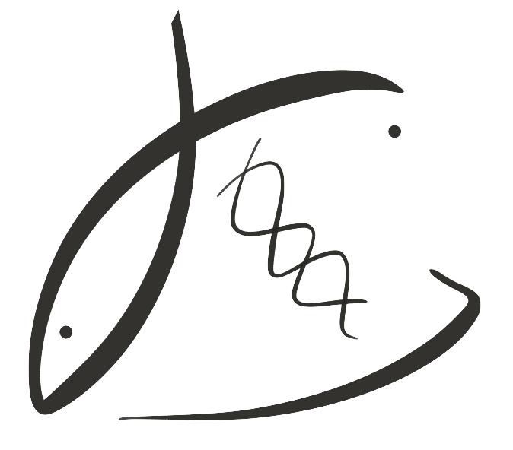
Impact of ocean acidification on geoduck in a natural setting
Leveraging eelgrass and estuaries to assess how geoduck respond to pH
Laura H Spencer, UW SAFS
Micah Horwith, WA DNR
Alex Lowe, UW Biology
Emma Timmins-Schiffman & Brook L Nunn, UW Genome Sciences
Sean Bennet & Steven Roberts, UW SAFS
Notes:
Thanks for having me. My presentation today is on the impact of ocean acidification on geoduck in a natural setting.... Where we leverage eelgrass beds to assess how geoduck respond between environments.
The collaborators on project were instrumental .., including folks from …

Slide 2
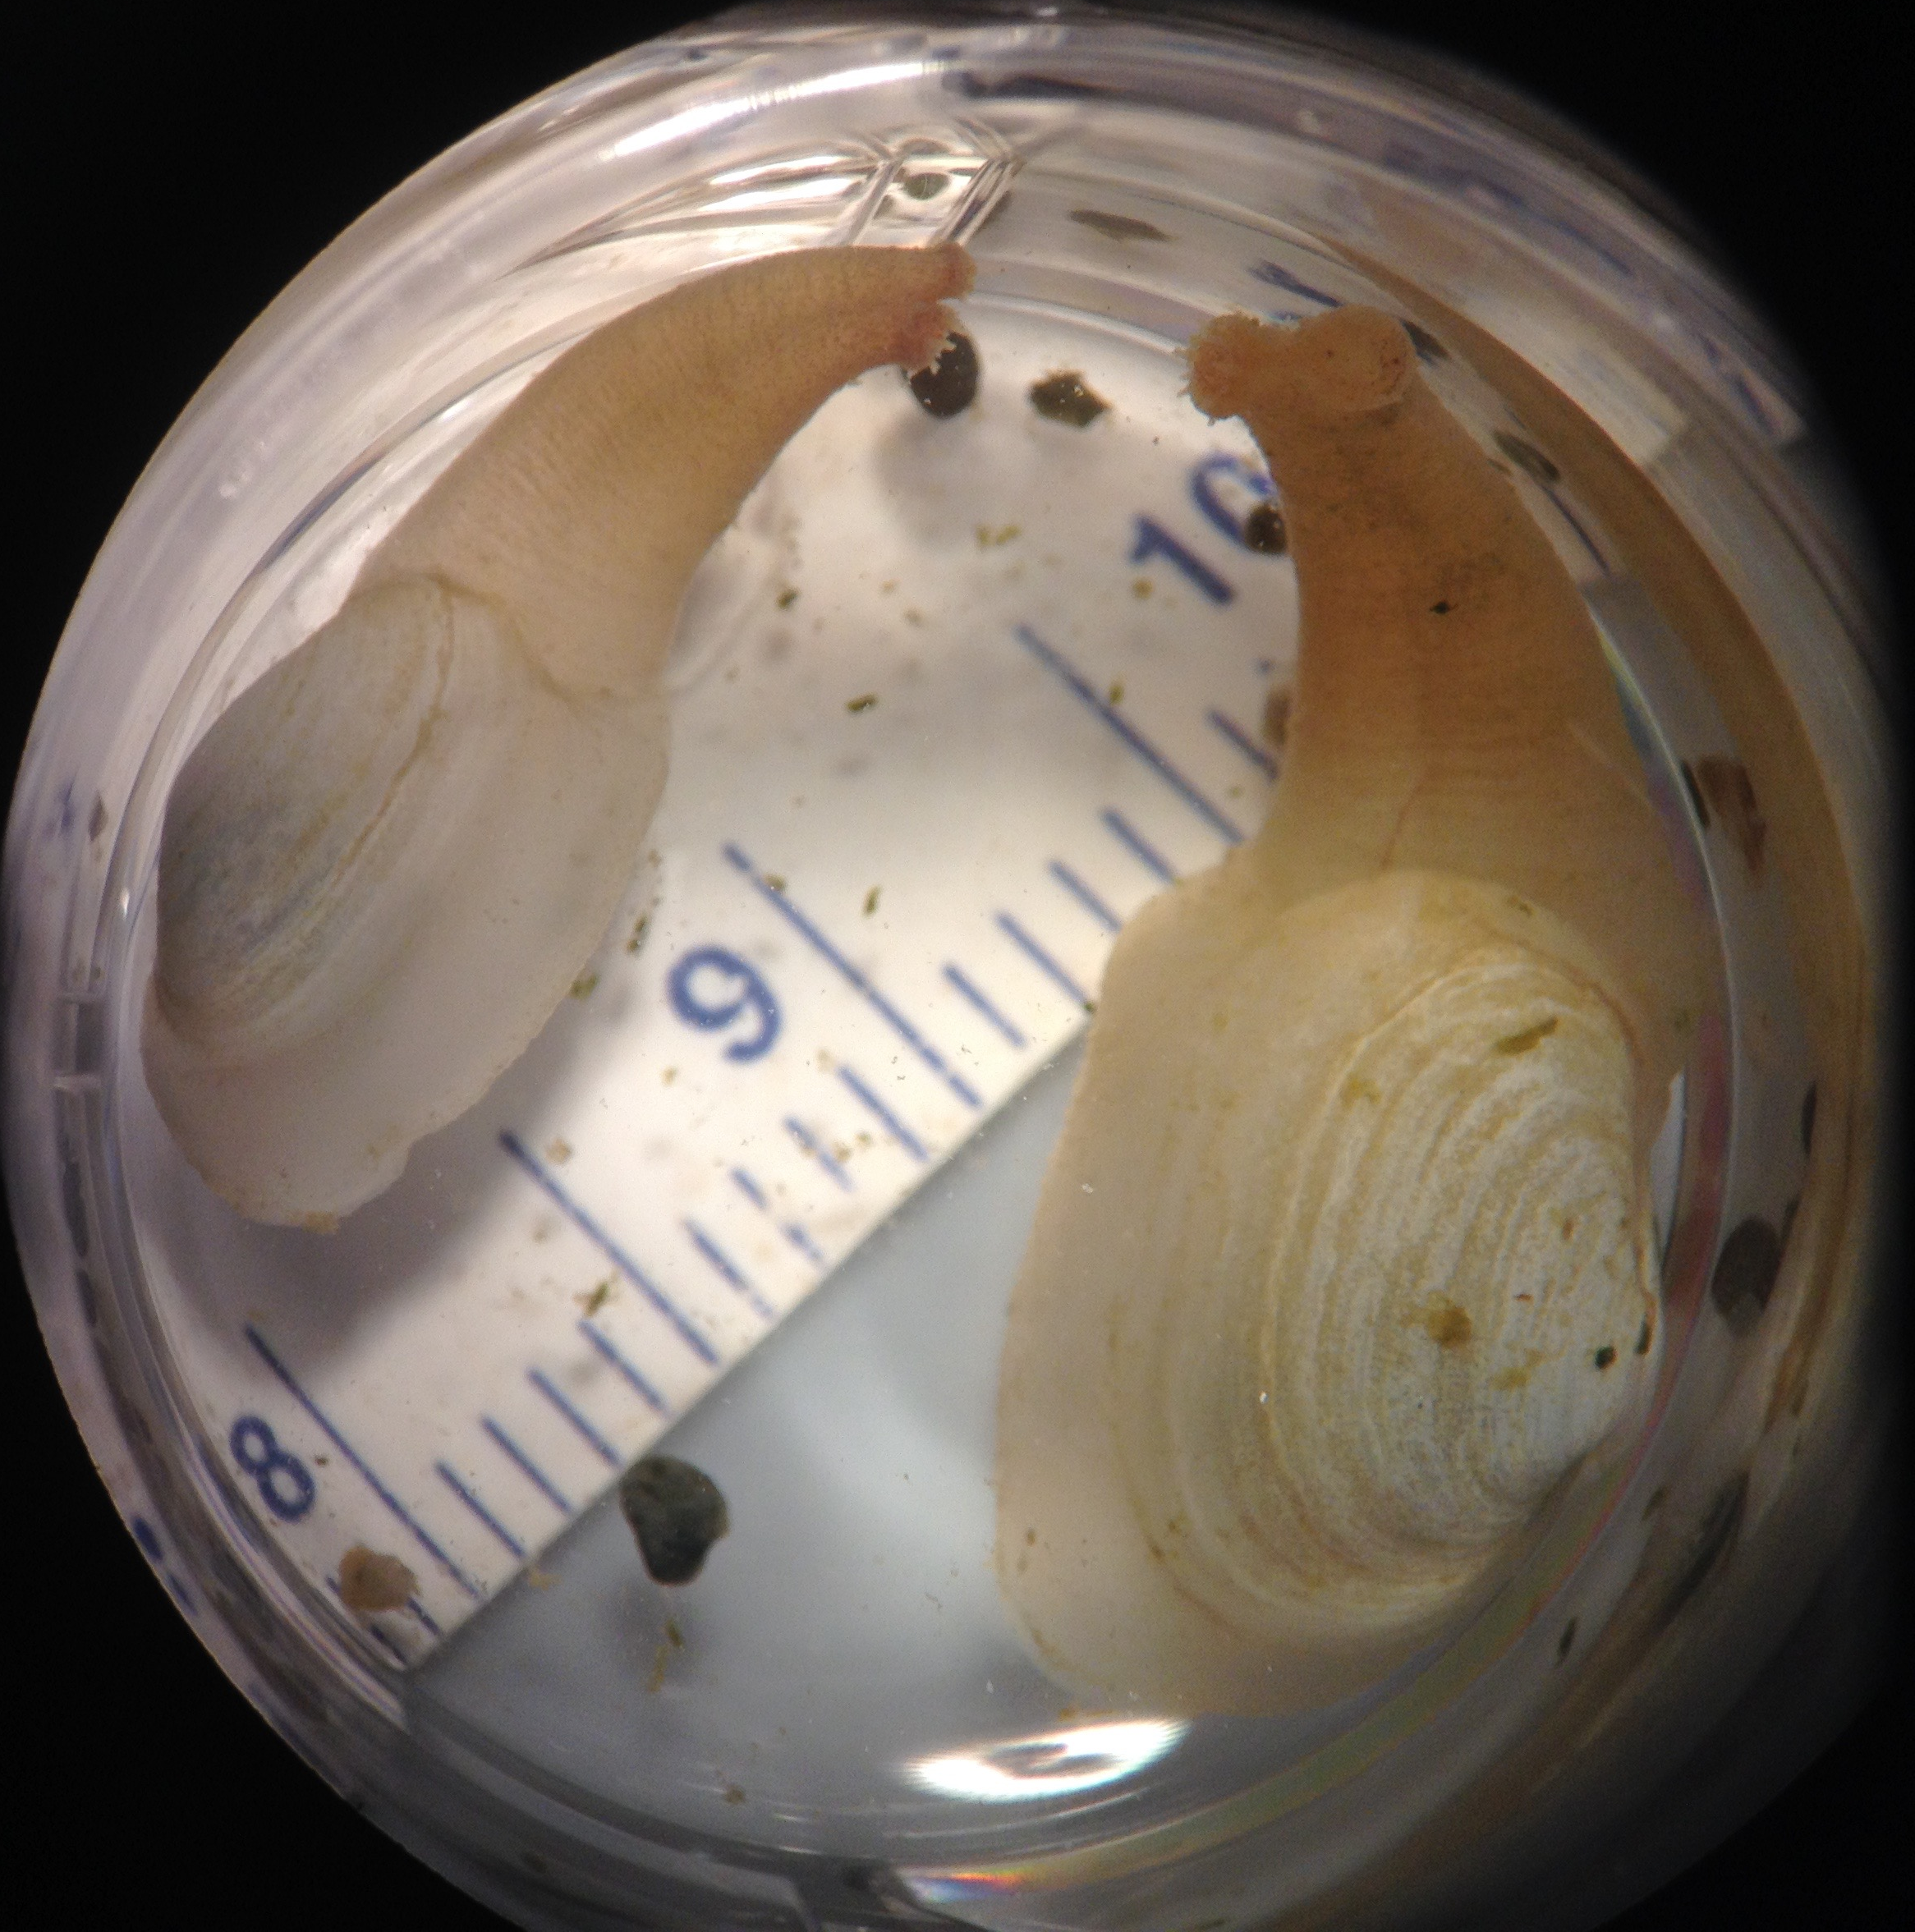
THE GEODUCK Panopea generosa
Native to WA
Valuable & growing industry
27% WA shellfish aquaculture revenue, ($24.5M in 2013), but only 7% by weight*
*WA Sea Grant report, 2015
Notes:
Pacific geoduck is …
While the geoduck industry is growing, producers and resource managers realize that ocean conditions are changing, and ocean acidification in particular, could threaten this industry. We have limited data in terms of published studies on the optimal growing conditions for geoduck, and no published studies yet on Pacific geoduck’s response to OA. So, my collaborators and I set out to see how geoduck growth, survival and physiology responds to low pH conditions.

Slide 3
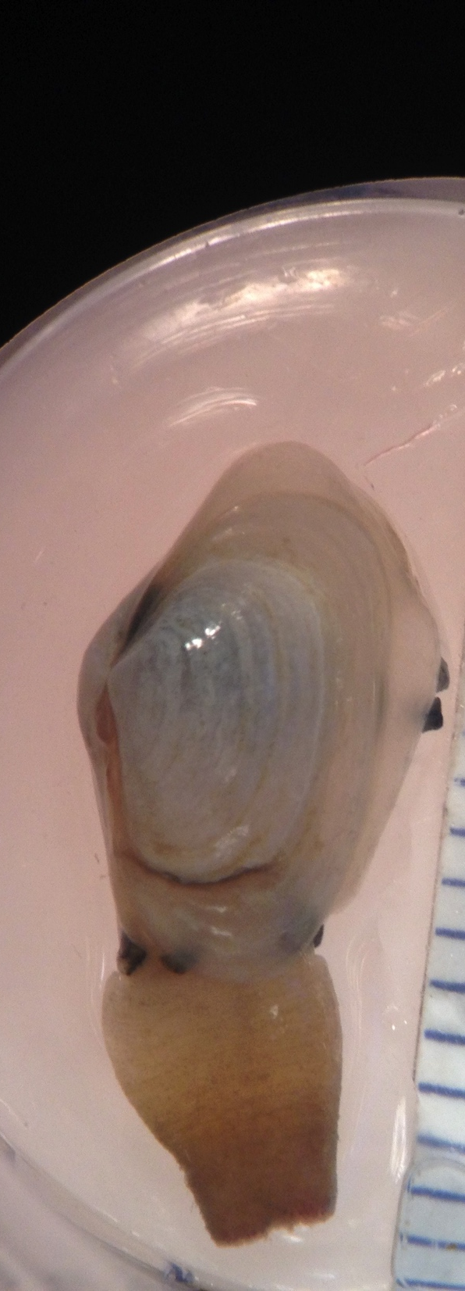
Directions in Ocean Acidification research
Multiple stressors: low pH/Ω with hypoxia, high temperature …
Natural pH fluctuations, e.g. diurnal
Environmental heterogeneity: fluctuating & variable temperature, salinity, DO, food availability …
Notes:
In planning the study, we wanted to incorporate recommendations that many OA researchers have made, for example:
Multiple stressors, e.g. temperature, hypoxia
Natural pH fluctuations, e.g. diurnal
Impact of OA in context of natural environmental variability
Controlled lab studies cannot mimic the heterogeneity and variability of a natural setting, so …
Multiple stressors, e.g. temperature, hypoxia
(Reum et al. 2016, Przeslawski, Byrne, Mellin 2015, Kroeker et al. 2013, Harvey et al. 2013)
Natural pH fluctuations, e.g. diurnal
Frieder et al. 2014, Cornwall 2013, Boyd et al. 2016
Impact of OA in context of natural environmental variability
Boyd et al. 2016, Gunderson, Armstrong, Stillman 2016

Slide 4
The Questions
How does pH affect juvenile geoduck growth, survival, and physiology in a natural setting?
Field outplant, observed changes in naturally occurring high/low pH
Our study leverages:
Washington estuaries – relatively acidic
Sub-basins of Puget Sound, Willapa Bay – environmental heterogeneity
Notes:
To address these recommendations, we conducted a field study, where we outplanted animals, and observed how pH conditions affect the animals.
We leverage the relatively low pH conditions found in Washington State estuaries, and the broad range of conditions occurring between subbasins of Puget Sound and Willapa Bay.

Slide 5
The Questions
Can we leverage carbon sequestration capacity of eelgrass to test pH effect on shellfish?
Hypotheses:
Eelgrass beds compared to adjacent unvegetated:
⬆ pH ⬆ geoduck survival ⬆ growth
⬇ expression of stress-related proteins
Notes:
Because eelgrass consumes CO2 during photosynthesis, many predict that they can mitigate the effect of fossil fuel emissions on seawater pH and calcifying organisms, creating a more suitable microhabitat inside the eelgrass bed. We

Slide 6
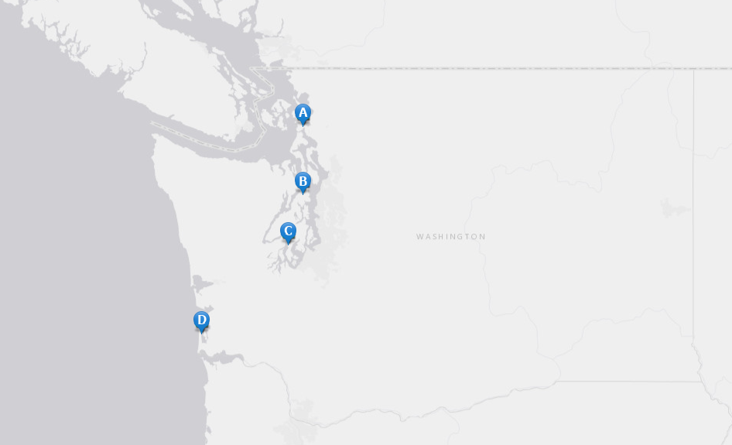
Geoduck outplanted in *low and *high pH, varying background conditions
Sibling juvenile geoduck
Duration = 30 days
4 bays
2 habitats / bay:
Unvegetated (low pH)
Eelgrass (high pH)
Fidalgo Bay
Port Gamble Bay
Case Inlet
Willapa Bay
Unvegetated
Eelgrass
*low and *high pH = relative to each other
Notes:
As mentioned, this was an outplant study.
Sibling juvenile geoduck were split into 4 groups, and outplanted in throughout Washington for one month, from June to July.
3 sites spanned Puget Sound from north to south, and one site was in Willapa Bay.
Each site also included 2 habitats, eelgrass beds and bare sediment.
Placed a suite of probes at each site to monitor water quality
At end of month sampled the animals for gill tissue, & extracted proteins

Slide 7
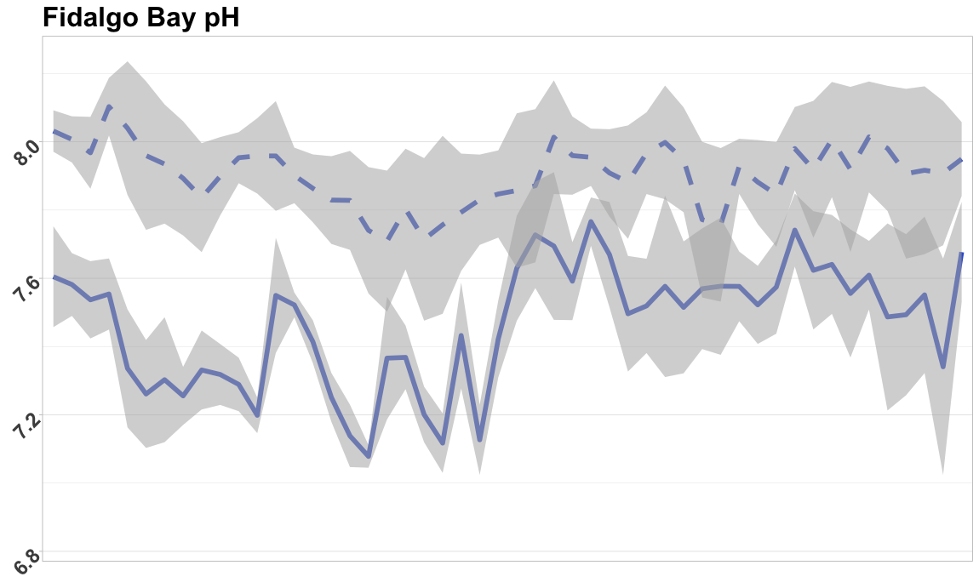
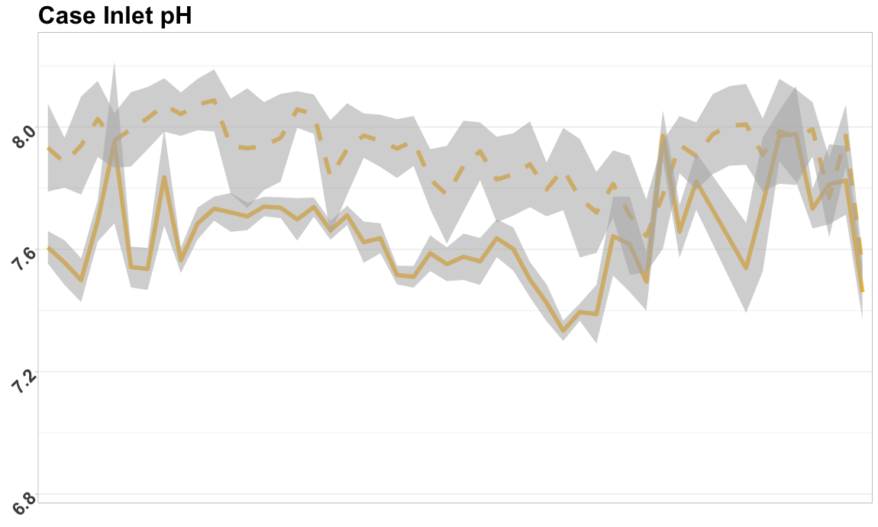
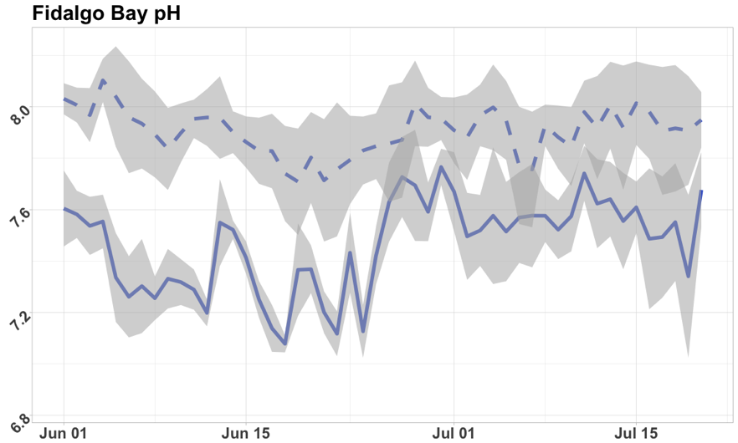
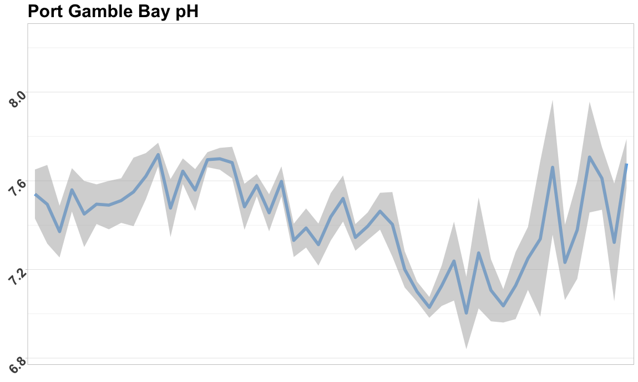
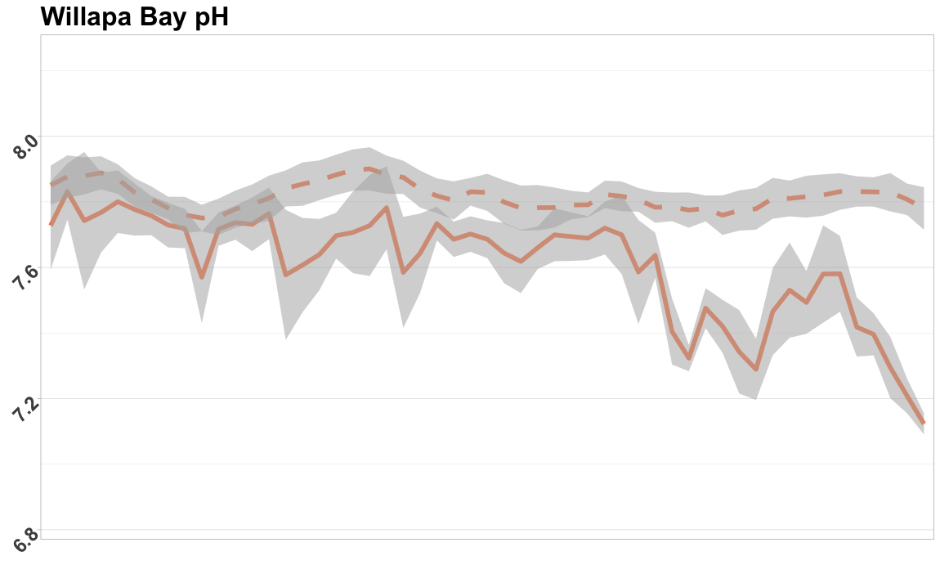
pH data show eelgrass effectively altered pH
Dashed is eelgrass
Solid is unvegetated
Notes:
Sell: variability in pH – sell!
Make all y-axes same
Don’t say “probe failure”

Slide 8
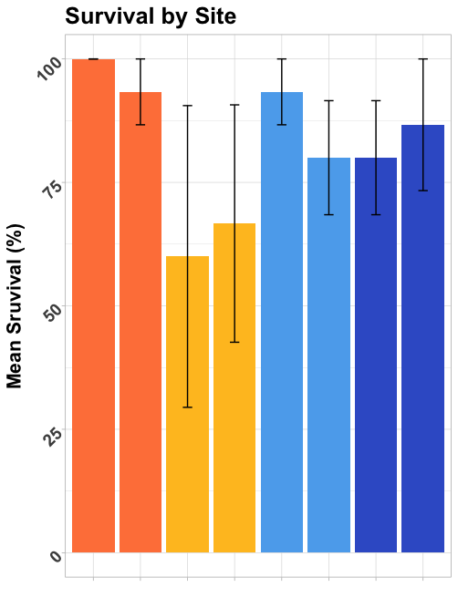
Survival not significantly different
Fidalgo Bay
Port Gamble Bay
Case Inlet
Willapa Bay
Unvegetated
Eelgrass
Notes:
As mentioned, this was an outplant study.
Sibling juvenile geoduck were split into 4 groups, and outplanted in throughout Washington for one month, from June to July.
3 sites spanned Puget Sound from north to south, and one site was in Willapa Bay.
Each site also included 2 habitats, eelgrass beds and bare sediment.
Placed a suite of probes at each site to monitor water quality
At end of month sampled the animals for gill tissue, & extracted proteins

Slide 9
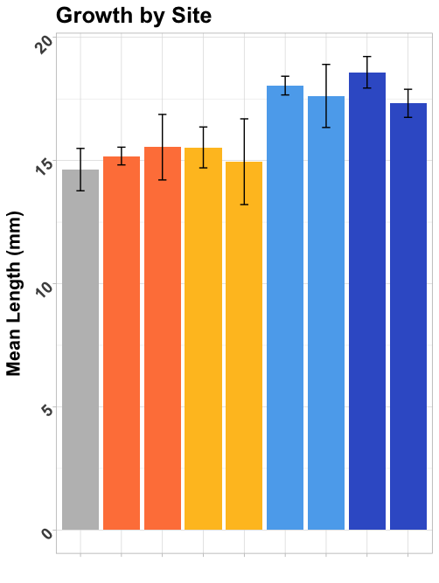
Growth differed by bay (p=5.5e-10) northern bays vs. southern bays (p<2e-16)
Fidalgo Bay
Port Gamble Bay
Case Inlet
Willapa Bay
Initial size
Unvegetated
Eelgrass
4%
6%
6%
2%
23%
20%
27%
18%
Relative % Growth
Notes:
Plot comparison between mean initial length
Final mean for each site / initial mean = ratio (no error bars)

Slide 10
Physiology assessed via proteomics: targeted proteins that respond to environment
PROTEIN | Response to…
Heat Shock Protein 90-alpha | General Stress, repair
Heat Shock Protein 70 | General Stress, repair
Superoxide Dismutase | Oxidative stress
Catalase | Oxidative stress
Peroxiredoxin-1 | Oxidative stress
Puromycin-sensitive aminopeptidase | Oxidative stress, growth
Protein disulfide-isomerase | Oxidative stress
Ras-related protein Rab-11B | Acidic pH
Sodium/Potassium-transporting ATPase subunit alpha | pH changes
Glycogen Phosphorylase (muscle form) | Carbohydrate metabolism
Trifunctional enzyme subunit beta (mitochondrial) | Lipid metabolism
Cytochrome P450 | Toxins
Arachidonate 5-lipoxygenase | Inflammation
Notes:
Physiology assessed via proteomics, where we measured proteins in the gill tissue that we know respond to environmental factors, and metabolism.
Proteomics allows us to get a snapshot into where energy is being directed in the animal, which we can’t see by measuring simply growth.
This is the list of 13 proteins
I focused on proteins triggered by environmental changes, such as general stress response proteins, oxidative stress or pH changes
With the abundance data for these 13 proteins, we can see if there are any patterns in geoduck placed in our four sites.

Slide 11
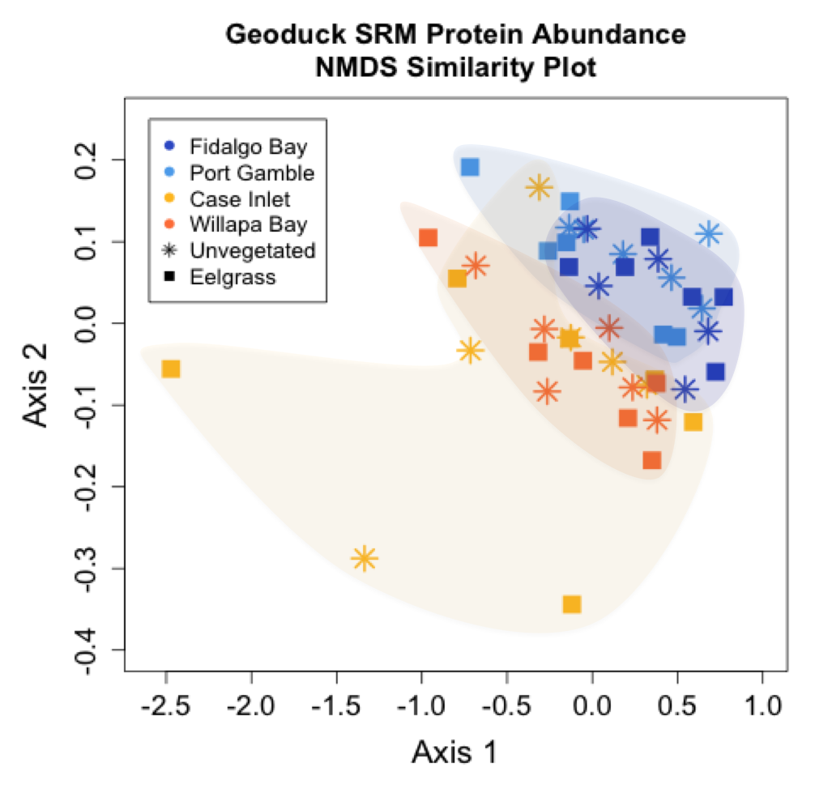
No protein differences by pH Proteins differed by latitude (north vs. south)
Fidalgo Bay
Port Gamble Bay
Case Inlet
Willapa Bay
Unvegetated
Eelgrass
Notes:
On the left is an NMDS plot, (NMDS), which allows us to visualize patterns in our abundance data.
On this plot, each point represents a geoduck sample
Points are color coded by site
Closer points are to each other, more similar the abundances are for the 13 proteins.
If there was no difference between geoduck placed at different site, the colors would be all mixed together,
But we see a clear clustering by site, and a geographical separation, where the northern-most sites (FB, PG) are more similar to each other than they are to the southern sites (CI, WB). This site difference is confirmed with an analysis of similarity test, P=.03.
LOTS to digest:
* on map point to what everyting means visually
* There’s not a difference – the reason why that’s evident is between stars & blocks, but we do see some idfference by bay

Slide 12
Protein Differences between North & South
PROTEIN | Response to… | ANOVA P-Value
Heat Shock Protein 90-alpha | General stress, repair | 2.2e-6
Heat Shock Protein 70 | General stress, repair | ND
Superoxide Dismutase | Oxidative stress | 0.49
Catalase | Oxidative stress | 1.00
Peroxiredoxin-1 | Oxidative stress | ND
Puromycin-sensitive aminopeptidase | Oxidative stress, growth | 0.0027
Protein disulfide-isomerase | Oxidative stress, growth | 0.05
Ras-related protein Rab-11B | Acidic pH | ND
Sodium/Potassium-transporting ATPase subunit alpha | pH changes | 1.00
Glycogen Phosphorylase (muscle form) | Carbohydrate metabolism | 0.15
Trifunctional enzyme subunit beta | Lipid metabolism | 2.2e-7
Cytochrome P450 | Toxins | 0.41
Arachidonate 5-lipoxygenase | Inflammation | 0.61
Notes:
We then compare abundance data for each protein individually, and find that WHEN GROUPED by SITE three proteins are significantly different (highlighted in red).
All three involved in re-folding of denatured, or unfolded proteins, & assisting in degradation of overly damaged proteins.
Heat Shock protein is a misnomer; production is triggered by heat shock, but it is also produced in response to other stressors that also cause damage and unfolding of proteins.
Also ran Krusgal Wallis rank-sum tests. Results for All proteins = Chi-Sq: 115; df=3; p-value<2.2e-16

Slide 13
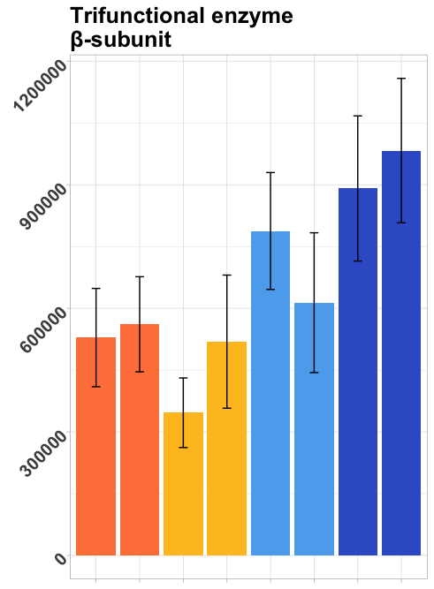
Metabolism, growth, repair proteins significantly higher in northern bays
Fidalgo Bay
Port Gamble Bay
Case Inlet
Mean spectral abundance
Willapa Bay
Unvegetated
Eelgrass
Notes:
Likely has something to do with metabolism and growth –
Replace with different plot
We found geoduck at different sites have different amounts of 3 proteins related to stress response. But at which sites are they producing more? This is a box plot for HSP90.
The X axis is abundance
Boxes are organized by latitude along the Y.
We again see a geographical pattern, where FB & PGB to the north have higher levels of the stress protein.
This pattern is consistent across all three proteins.
What’s interesting is how the environmental data compare.
This is a bar plot of the mean DO data over the month at each site. DO is higher in northern sites, where stress protein is higher.
Similarly, pH is much lower in the northern sites
A recorded mean pH of 7.1 is indeed very low, with historic levels in Puget Sound in the high 7’s (e.g. 7.8 @ Ken Chew)
Low pH can cause high levels of reactive oxygen species, or free radicals, causing oxidative stress and cell damage.
Similarly, DO of 12 & 14.5 at the northern sites would be highly over-saturated, 100% saturation would be near 9ppm.
SUPER-saturation of DO can also resulting in cellular oxidative stress.
Laboratory studies do show this type of damage as a result of low pH and supersaturated oxygen.
Perhaps these 2 factors are having a compounding effect, and resulting cellular damage, triggering production of stress response proteins.
HOWEVER: outplant studies- other factors could cause damage (e.g. chemical toxins).
REGARDLESS, THIS DATA INDICATES geoduck @ PG&FB pooling more energy into producing stress proteins, thus having less energy for processes like growth, immune system, and this correlates to acidic, and oxygen supersaturated water.
Diff. confirmed: Dunn's test of multiple comparisons using rank sums

Slide 14
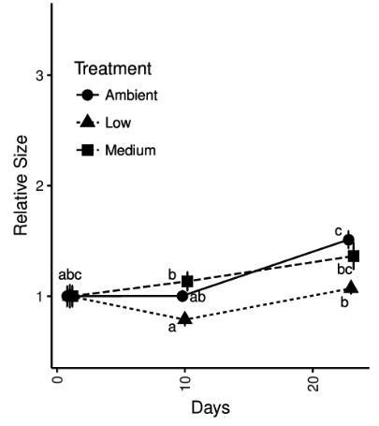
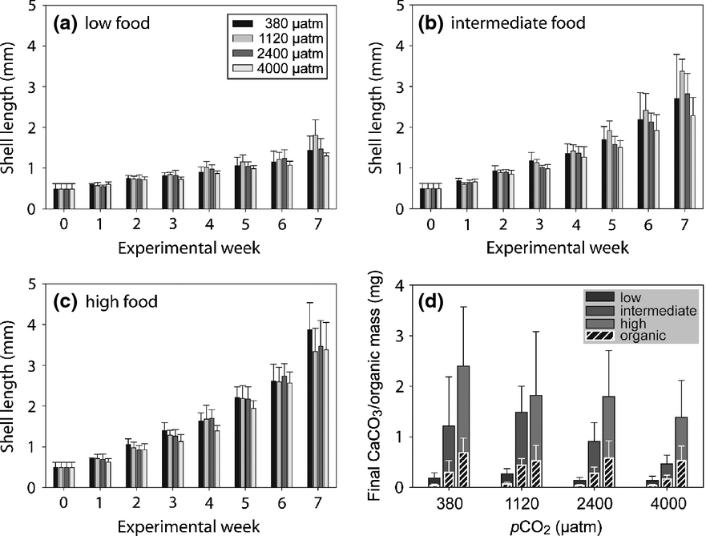
No pH effect in natural setting, but it’s complicated.
Growth differed by site, maturity expected earlier in northern sites (where there is limited aquaculture!)
pH was not primary determinant of phenotype
Controlled OA studies should be coupled with outplant studies
⬇ growth in ⬇ pH
Putnam et al. in press
Food availability > pH
Thomsen et al., 2014
Notes:
This is not to say that pH did not have an effect on the animals, it may have just been overshadowed by other factors that are more important.
Show Hollie’s plot – initial exposure – our lab did a lab-based trial where we did see a negative growth impact.

Slide 15
Conclusions & Next Steps
Findings
Eelgrass beds effectively increased ⬆pH
No differences in growth, survival, or stress-related proteins observed between pH
Faster growth and more metabolic/growth proteins in northern bays
Future studies
Monitor proteins over time – how dynamic are they? Why poor performance in Case Inlet?
Compare chlorophyll data between bays – more phytoplankton in northern bays?
Assess proteins for use as site suitability assays
Notes:
Overall:
Remarkable that sibling geoduck, separated for 1 month, have clear physiological differences between sites, measured in three stress-related proteins
There is a geographical pattern, where geoduck placed in northern sites produced more stress-proteins, correlated with lower pH and higher DO
More Next Steps:
(Gill transcriptome, can use to more accurately ID the 8k proteins.)
Ultimate goal: could use these proteins for short-term site-assessment outplants : placed a few geoduck @ different locations, ID which is best for aquaculture

Slide 16




Thank you…
Emma Timmins-Schiffman & the rest of the Brook Nunn & McCoss labs, UW Genome Sciences
Micah Horwith, WA Department of Natural Resources
Alex Lowe, UW Biology
Yaamini Venkataraman, Jose Guzman, Grace Crandall, Sean Bennet, Steven Roberts, UW SAFS
This work is supported by NSF GRFP
Notes:
Benefits of 2-phase proteomics
Why not use other method of measuring proteins?
Phase 1 – the memory-intensive step- is only required once, and results can be used again. I now have 8k proteins detected, and anyone could use as targets for future studies.
Phase 2 is inexpensive; depending on the # of target proteins, cost could be $20-$50 per sample
This 2-phase allows us to potentially ID unexpected proteins
Works with new species once transcriptome is available; doesn’t have to be tissue-specific.
Proteomic response to elevated PCO2 level in eastern oysters, Crassostrea virginica: evidence for oxidative stress, Lars Tomanek etc., 2011
Low pH and ROS, all investigated in mammals:
High pCO2 series of reactions to form ROS
“Low intracellular pH triggered by environmental acidification may negatively affect the efficiency of the mitochondrial electron transport chain (ETC) by increasing electron slip in ROS-generating mitochondrial … would result in elevated rates of ROS generation.”
Low pH can cause a release of transition metals, such as iron, which can oxidize molecules and cause oxidative stress
Animal response to drastic changes in oxygen availability and physiological oxidative stress, Marcelo Hermes-Lima, Tania Zenteno-Savın, 2002
COST: Need exact number.
$300/day, 7 days (including dilution curve etc. & some extra time), + extraction kit cost
ANOSIM:
Non-parametric
Although individual observations (transitions) are expected to be independent, individual species variables are not independent of one another.
A distribution of the statistic under the null created via permutations of the observations

Slide 17
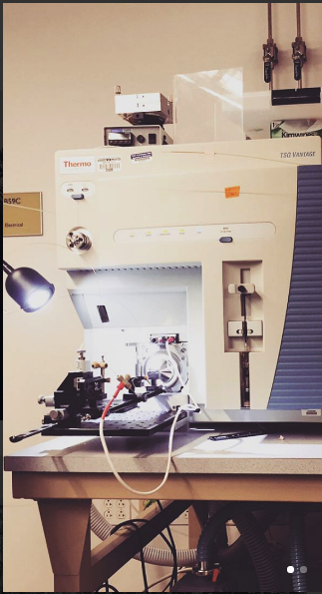
Physiology assed via Proteomics
Proteins…
carry out most cellular activity
change based on environment, are dynamic
provide direct measure of physiology, energy allocation
Notes:
Proteomics is the study of all proteins at the cellular level.
Proteins carry out most cellular activity, and the composition of proteins in the cell can be dynamic, changing based on developmental stage, immune response, and changes in the environment.
Organism experiences a change in temperature, oxygen, etc., certain proteins respond maintain homeostasis, to avoid cell damage
Because these proteins quickly respond to environmental changes, measuring them provide us a direct, sensitive view of the animal’s physiology and energy allocation.
Therefore, we can then measure proteins that we know are triggered by environmental changes, to assess where the animals resources are being directed.

Slide 18
Protein analysis in 2-phases
PHASE I
Protein Discovery
PHASE II
Targeted Protein Quantification
8 samples
2 per site
48 samples
12 per site
Captured all proteins
Measured 8,076
targeted 13 proteins
116 transitions
Identified 5,690 proteins via transcriptome
Quantified abundance
Selected proteins based on:
Detectability
Quality
Biological Function
Assessed similarity
between sites
Notes:
We measured protein composition in 2 phases, both using a mass spectrometer.
Phase 1: on left
Discovery phase, where we determine which proteins we can clearly measure in our gill tissue?
Aka: Shotgun Proteomics
Highly memory intensive, limited by the number of sample we can process.
Ran 2 geoduck samples per site, measured total of ~8k proteins, and ID’d 5,700.
From 5,700 known proteins we selected a handful to investigate further.
Proteins selected based on detectability across all samples, quality of signal, and biological function.
Phase 2: on right
Targeted quantification phase, we can precisely measure the amount of each proteins we’ve selected in each geoduck sample.
Less intensive, ran 12 per site, targeting 13 proteins
The data we collected from phase 2 was quantity data, and were able to compared abundance between sites.

Slide 19
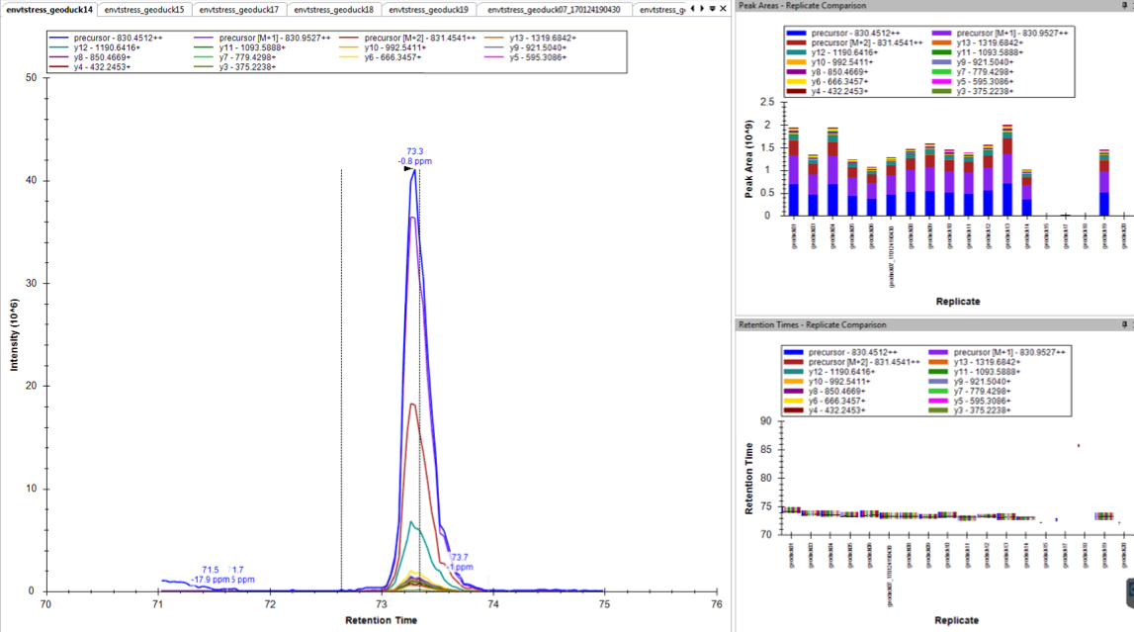
Selected proteins have strong, clear signal
gigasin
Poor quality
Good quality
Heat Shock Protein 70
Notes:
In case I need this info:

